Slide 1
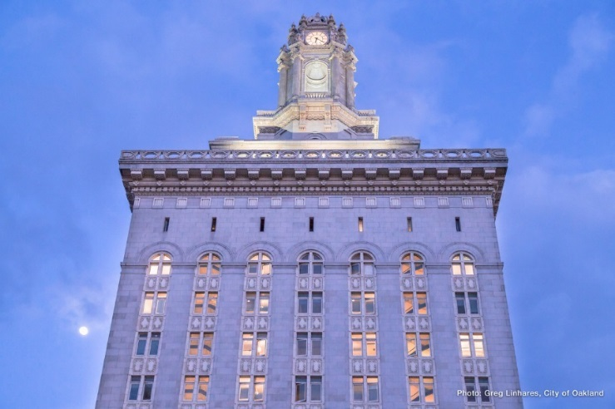
Limited Public Financing Program
Presented by
Public Ethics Commission

Slide 2
Public Ethics Commission
Commission staff:
Executive Director, Kellie Johnson
Investigator, Simon Russell
Lead Analyst, Suzanne Doran
Ethics Analyst, Jelani Killings
Administrative Assistant, Ana Lara
Commissioners:
Arvon J. Parteet, Chair
Ryan Micik, Vice-Chair
Charotte Hill
Joe Tuman
Francis Upton IV

Slide 3
PEC History
Founded in 1996 with the goal of ensuring “fairness, openness, honesty and integrity" in city government.
PEC Jurisdiction
Government Ethics Act (GEA)
Oakland's Campaign Reform Act (OCRA)
Sunshine Ordinance
The Limited Public Financing Act (LPFA)
The Lobbyist Registration Act
Oakland's False Endorsement in Campaign Literature Act

Slide 4
Limited Public Financing Program
Provides a limited amount of funding by way of reimbursements to a District City Council candidate’s campaign for certain campaign expenditures.
LPF Act was created in 1999 to:
Ensure individuals have a fair and equal opportunity to participate in the elective and governmental process
Reduce the influence of large contributors
Ease the pressure on candidates to raise large amounts of money
Encourage competition for elective office
Allow candidates to spend less time fundraising and more time dealing with important constituent and community issues

Slide 5
Funds Available
Total amount available in the Limited Public Financing Account = $177,000
Phase I = Total funds will be divided evenly among all candidates who opt into the program and meet Form 1 deadline (Aug. 31st)
Phase II = Redistribution of untouched Phase I funds after the initial Form 3 deadline (Sept. 19th) to only those who submitted at least one Form 3 packet
8 candidates were certified by the City Clerk (for District City Councilmember Districts 2, 4, 6)

Slide 6
Phase I
Total amount of funds available to each candidate for Phase I is
at least $22,125
(Amount depends on
how many candidates
opt-in by Aug. 31)
District Number | Certified Candidates
2 | 2
4 | 2
6 | 4

Slide 7
Phase II
Any candidate who submits an initial Form 3 reimbursement packet (for a reimbursement of at least $1,000) by September 19 will be eligible to receive a second amount available for reimbursement.
Any candidate who does not submit an initial Form 3 packet will no longer be eligible for any LPF funds.
Candidates who do not meet the Sept 19 deadline will lose their initial apportionment, and those funds will be redistributed to the other candidates who completed a Form 3 packet.
The PEC will calculate Phase II funds by October 1, and will notify participating candidates of the new amount available.
Goal = to maximize the use of LPF money available

Slide 8
How to Accept LPF Program Participation (Opting-in)
File LPF Form 1 by August 31, 2022, accepting participation in the LPF program.
Must be filed with the Public Ethics Commission, not the City Clerk
Must have already filed OCRA Form 301 accepting voluntary expenditure limits
Failure to file the acceptance by August 31 will constitute a rejection of public financing for the November 2022 election.

Slide 9
Application Requirements
File LPF Form 2 – Application for Public Financing
Must acquire an Employer ID Number from IRS
Must meet the requirements specified in the form:
Filed Form 1 by August 31, 2022
Certified to appear on the ballot for the 2022 election
Received campaign contributions totaling at least 5% of the voluntary expenditure ceiling (copies of front and back of checks)
Made campaign expenditures of at least 5% of the ceiling
Cannot contribute own money of more than 10% of the ceiling
Candidate/campaign treasurer/designee must attend a PEC training
Must be opposed by a candidate for the same office
Must file all pre-election and post election campaign statements

Slide 10
How to Receive Reimbursements
File LPF Form 3 – Reimbursement Claim Form
Initial Form 3 submission must be filed with PEC by the September 19, 2022 deadline (5:00 p.m.).
Additional Form 3 Reimbursement Requests may be filed on a rolling basis after the first submission on Sept 19.
Must be filed in increments of at least $1000 (or $500 in the last 10 days before the election)
Should itemize payments (use PEC Form 3 Cover sheet)
Only certain types of expenditures are eligible for reimbursement
Must include copies of the following:
Billing invoices
Checks used to pay the invoices (copies of front and back of check)
Applicable campaign material (the “thing” purchased), where applicable

Slide 11
Receiving Reimbursements Continued…
Submit Form 3 and attachments to the Public Ethics Commission.
Checks will take approximately 10 days to process and will be mailed to the campaign address provided on vendor application form.
Reimbursement checks must be deposited into the campaign account within 30 days of receipt.
Deadline for submitting reimbursement claims is 5:00 p.m. November 7, 2022, the day before the election.

Slide 12
Post-Election Procedures
By January 31, 2023, candidates must return a certain portion of surplus funds left in the campaign account as of December 31, 2022.
Amount of funds to be returned must be the percentage of total contributions received that the LPF funds constituted.
Example: If you raised $50,000 during your campaign, and received $10,000 in LPF funds (20%), and you have $12,000 left on December 31, you must return $400 (your remaining funds less LPF funds received multiplied by 20%) to the City.
LPF Form 4 provides a formula for your calculation.
Note: PEC staff can help you calculate your surplus funds amount to be returned.

Slide 13
Review and Enforcement
All campaigns receiving LPF funds will be audited for compliance with the law by the City Auditor.
Public Ethics Commission may impose fines, penalties, and require the return of LPF funds for a violation of the LPF Act.

Slide 14
We Want Your Feedback
How did the program benefit your campaign? What can be done to improve the program?

Slide 15
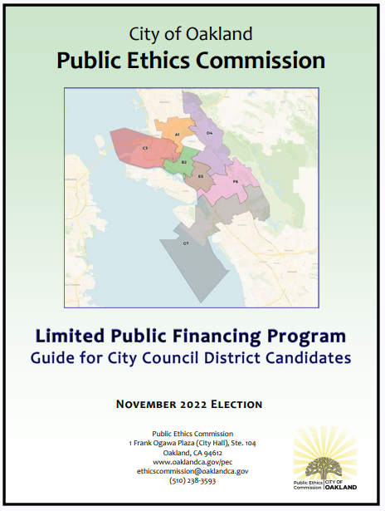
Additional Information
Jelani Killings
Phone: (510)484-1292
Email: jkillings@oaklandca.gov
Electronic versions of LPF Forms can be found at www.oaklandca.gov
Search: PEC LPF Form (1,2,3,4)

